Slide 1
Augmented
Analytics
Dehayco, Renomeron, Bacay

Slide 2
Augmented
Analytics
Analysis, interpretation and insight finding
Transforming of “Big Data” into smaller data which is more conclusive
20%
Taking the necessary action
80%
Collection and preparation of “Big Data”
THE WORK OF A DATA SCIENTIST

Slide 3
Augmented
Analytics
20%
80%

Slide 4
Augmented
Analytics
20%
80%

Slide 5
Augmented
Analytics
20%
80%

Slide 6
Augmented
Analytics
20%
80%

Slide 7
Augmented
Analytics
Time Spending Allotment
Machine Learning
20%
Collection and preparation of “Big Data”
SAVE!!!
Analysis, interpretation and insight finding
100%
Decision making
80%
Transforming of “Big Data” into smaller data

Slide 8
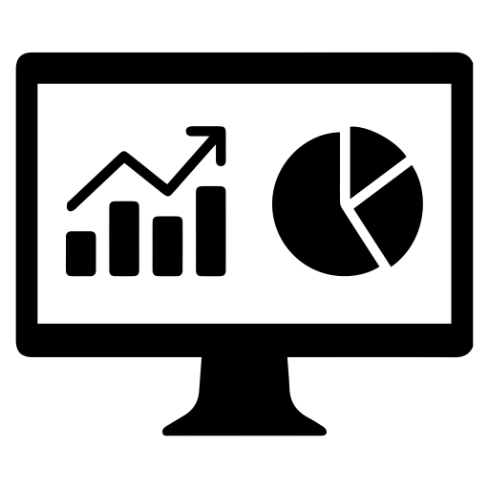



Reporting & Presentation
Machine
Learning
Human Bias

Slide 9
Augmented
Analytics
ULTIMATE GOAL

Slide 10

Augmented
Analytics
Taking the necessary action
Concluding
Analysis, interpretation and insight finding
Collection and preparation of “Big Data”

